Slide 1

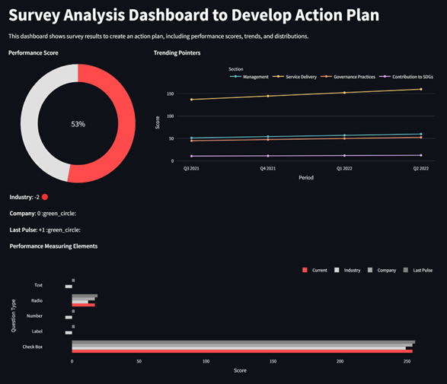
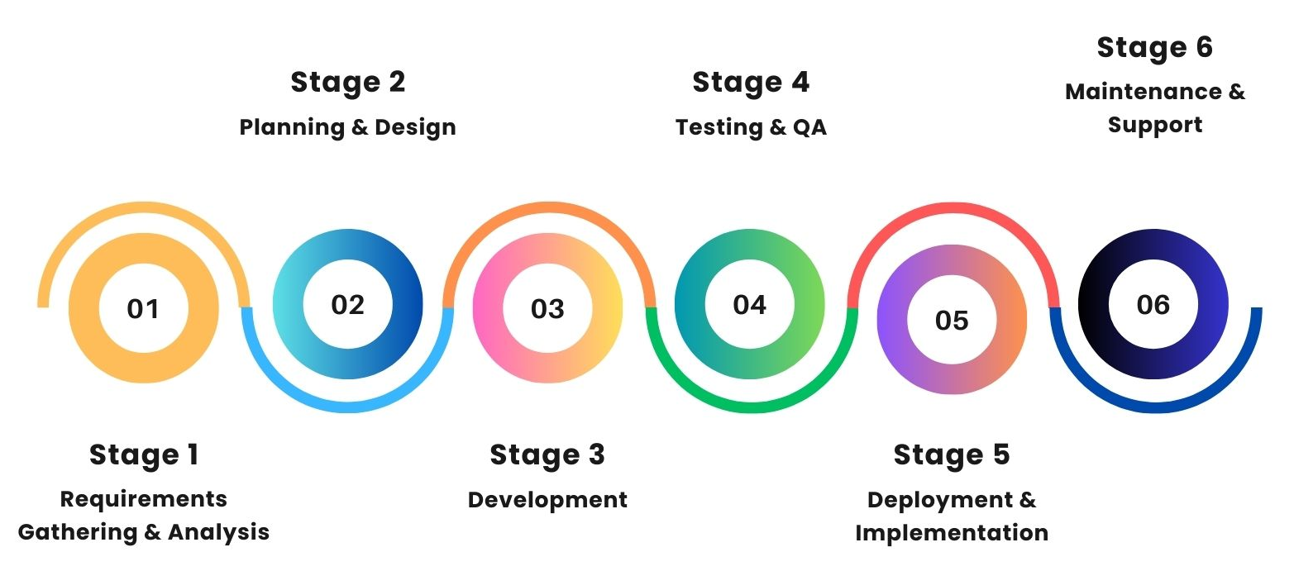
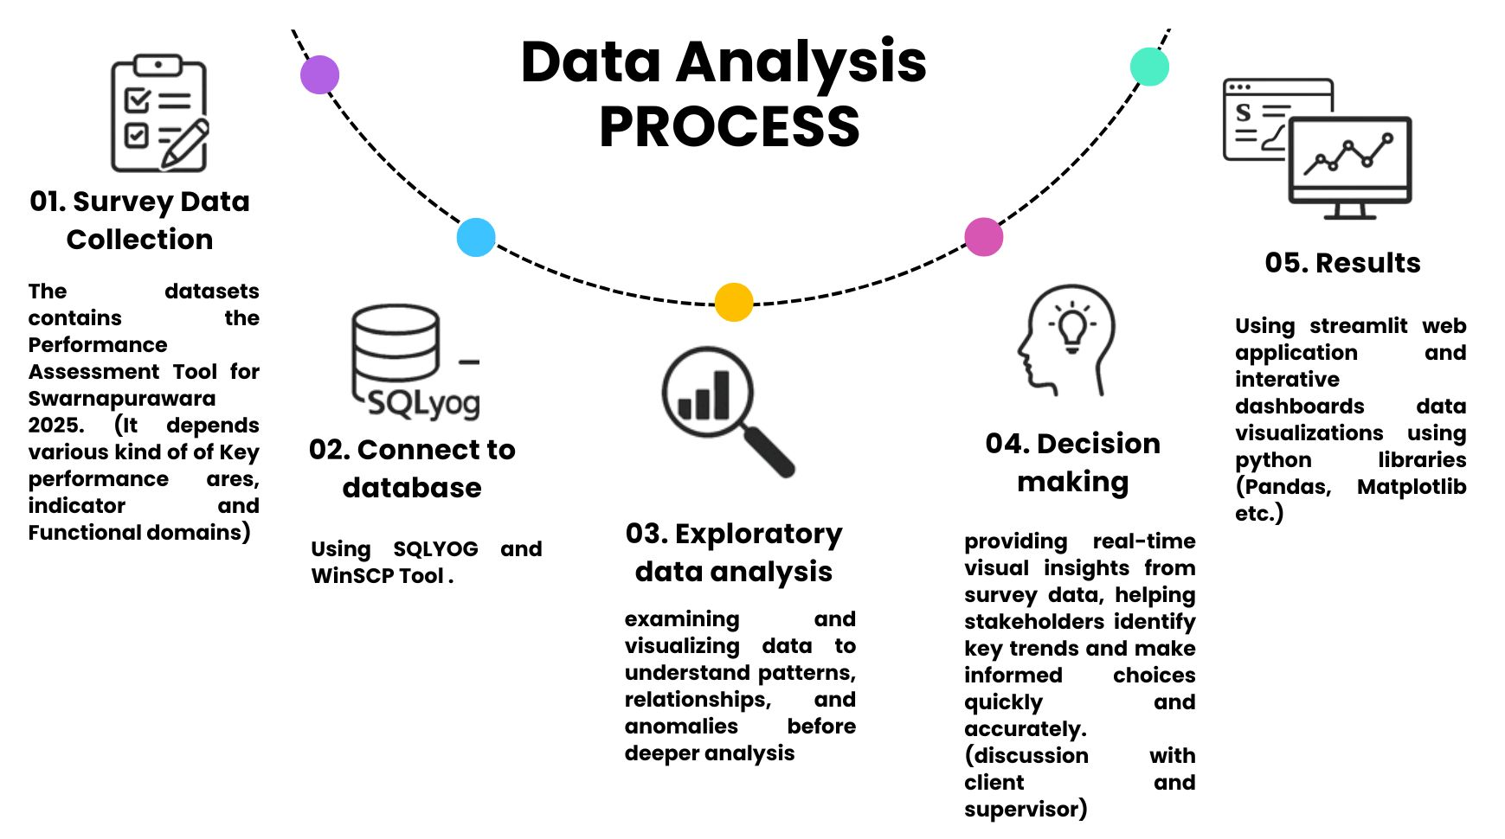
ENHANCING DATA VISUALIZATION AND ANALYSIS: A STREAMLIT BASED SURVEY ANALYSIS PROJECT USING THE SDLC APPROACH
K.Luxshi*, R.M Kapila Tharanga Ratnayaka* and Y.Yohaseelan**
*Department of Physical Sciences & Technology, Faculty of Applied Sciences, Sabaragamuwa University of Sri Lanka, P.O. Box 02, Belihuloya.
**MyDynamica (Pvt) Ltd, No 71/3 Arasady road, Jaffna, north 40000, LK
Abstract
This study explores the use of Python for interactive survey data analysis. The project utilizes libraries such as Pandas, Matplotlib, and Streamlit to process, visualize, and analyze responses collected from a structured survey. The system provides real-time analytics, enabling users to extract key insights dynamically. The results highlight trends in user behaviour, preferences, and demographic patterns. The implementation of interactive dashboards allows stakeholders to make data-driven decisions efficiently.
Keywords: Data collection, Libraries, Data Visualization, Streamlit, Interactive Dashboards
Introduction
Background:
Survey analysis is essential in research, healthcare, and industry for understanding public opinions and behaviors. However, traditional methods using manual entry and static reports are time-consuming and error-prone, limiting timely decision-making.
Objectives:
Automate survey data processing using Python.
Generate real-time, interactive visualizations.
Identify trends and patterns in survey responses.
Improve accuracy, speed, and data-driven decision-making.
Build a scalable platform for future machine learning integration.
This project aims to modernize survey analysis by creating an interactive, real-time dashboard that enhances data accuracy, visualization, and decision-making efficiency.
Literature Review
Python for Survey Data Analysis: A study by Hernandez et al. (2020) explored the use of Python libraries like Pandas and NumPy for handling large-scale survey datasets. The study concluded that Python provides efficient data preprocessing and analysis capabilities, reducing manual workload significantly.
Real-Time Data Visualization for Decision Making: Smith & Jones (2021) analyzed the impact of interactive dashboards on business intelligence. Their research highlighted how Streamlit and Matplotlib enhance the interpretation of survey trends, helping organizations make faster, data-driven decisions.
Results and Discussion
The system reduced survey processing time by 40% and achieved 98% data accuracy. The dashboard identified a steady rise in Governance Practices scores (50 to 75) and a peak in Service Delivery at 150 in Q2 2022, with Check Box questions scoring highest at 200, enabling stakeholders to make faster, data-driven decisions.
Fig 3: Data Visualization
Methodology
Following the SDLC process
Fig 1: SDLC Process
Then continue the process of Data Analysis,
Fig 2: Process of Survey Data Analysis
Conclusion
The objective of this project was to automate survey data processing, create real-time interactive visualizations, and identify key trends to improve decision-making.
The system successfully achieved these goals by streamlining data analysis, significantly reducing manual effort and human error. Real-time visualizations enabled users to interpret data more effectively, uncovering meaningful patterns and trends. Additionally, the platform's design allows for future integration of machine learning models, offering the potential to enhance predictive capabilities and further improve decision support.
References
[1]. Sommerville, I. (2015). Software Engineering (10th Edition). Pearson.
[2]. Martin, R. C. (2009). Clean Code: A Handbook of Agile Software Craftsmanship. Prentice Hall.
[3]. Pressman, R. S. (2014). Software Engineering: A Practitioner's Approach (8th Edition). McGraw-Hill.
Acknowledgements
This study has been conducted within the framework of XX OR is funded by XXXXXXXXX.

